Slide 1
Data Binding

Slide 2
Basic Data Binding
Associate a data source with a control and have that control automatically display the data.
Web controls such as TextBox, LinkButton, Image, and many more support single-value data binding
Repeated-value controls often create lists and grids (the ListBox and GridView are two examples) support repeated-value binding
Set the DataSource property
Call DataBind() method

Slide 3
Data Binding
Can bind any data structure that implements the ICollection interface or one of its derivatives
All in-memory collection classes, such as Collection, ArrayList, Hashtable, and Dictionary
An ADO.NET DataReader object, which provides connection-based, forward-only, and read-only access to the database
The ADO.NET DataView, which provides a view onto a single disconnected DataTable object
Any other custom object that implements the ICollection interface

Slide 4
Single-Value Binding
Could bind some of the control’s properties to a data binding expression in the .aspx markup portion of the page
Data binding expressions are always wrapped in the <%# and %> characters
<%# expression_goes_here %>
Must call the Page.DataBind() method
Examples of data binding expressions
<%# GetUserName() %>
<%# 1 + (2 * 20) %>
<%# "John " + "Smith" %>
<%# Request.Browser.Browser %>
Can place the data binding expressions anywhere on the page

Slide 5
Example page that uses several data binding expressions
<html xmlns="http://www.w3.org/1999/xhtml">
<body>
<form method="post" runat="server">
<asp:Image ID="image1" runat="server" ImageUrl='<%# FilePath %>' />
<br />
<asp:Label ID="label1" runat="server" Text='<%# FilePath %>' />
<br />
<asp:TextBox ID="textBox1" runat="server" Text='<%# GetFilePath() %>' />
<br />
<asp:HyperLink ID="hyperLink1" runat="server"
NavigateUrl='<%# LogoPath.Value %>' Font-Bold="True" Text="Show logo" />
<br />
<input type="hidden" ID="LogoPath" runat="server" value="apress.gif">
<b><%# FilePath %></b><br />
<img src="<%# GetFilePath() %>">
</form>
</body>
</html>

Slide 6
In script blocks or in the code-behind class
Protected Function GetFilePath() As String
Return "apress.gif"
End Function
Protected ReadOnly Property FilePath As String
Get
Return "apress.gif"
End Get
End Property

Slide 7
Calling DataBind()
Must call the DataBind() method of the containing page
Protected Sub Page_Load(ByVal sender As Object, ByVal e As System.EventArgs
) Handles Me.Load
Me.DataBind()
End Sub

Slide 8
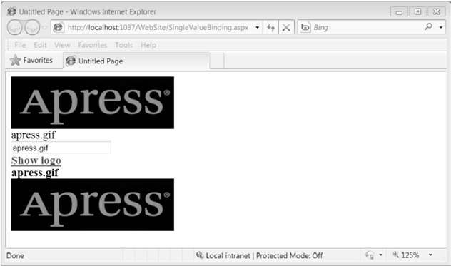
Single-value data binding in various controls

Slide 9
Other Types of Expressions
$ expressions
evaluated by an expression builder when the page is rendered
to retrieve an application setting named appName from the <appSettings> portion of the web.config file
<asp:Literal Runat="server"
Text="<%$ AppSettings:appName %>" />
don’t need to call the DataBind() method to evaluate $ expressions
Can’t be inserted anywhere in a page but need to be wrapped in a control tag and use the expression result to set a control property

Slide 10
Examples that use the ConnectionStringsExpressionBuilder
<asp:Literal Runat="server" Text="<%$ ConnectionStrings:Northwind %>" />
<asp:SqlDataSource ConnectionString="<%$ ConnectionStrings:Northwind %>" ... />

Slide 11
Repeated-Value Binding
Binds an entire list of information to a control
Basic list controls that support repeated-value binding
HtmlSelect, ListBox, and DropDownList controls
CheckBoxList and RadioButtonList controls
BulletedList control

Slide 12
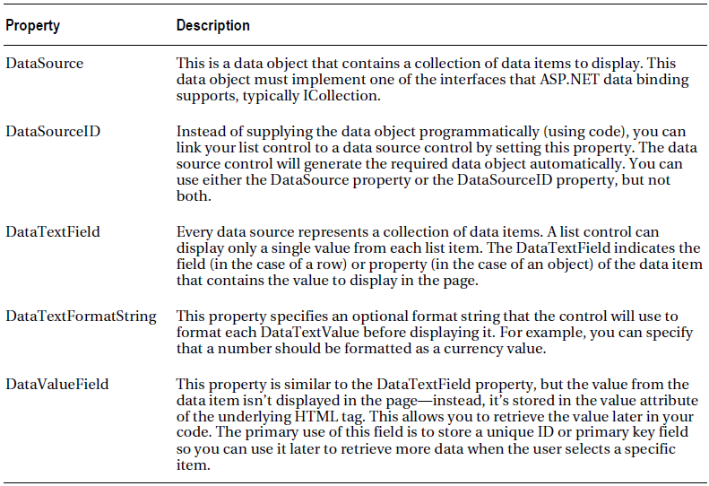
Data Properties for List Controls

Slide 13
Example
<table width="100%">
<tr>
<td>
<select runat="server" ID="Select1" size="3"
DataTextField="Key" DataValueField="Value"
name="Select1" />
</td>
<td>
<select runat="server" ID="Select2" DataTextField="Key"
DataValueField="Value" name="Select2" />
</td>
<td>
<asp:ListBox runat="server" ID="Listbox1" Size="3"
DataTextField="Key" DataValueField="Value" />
</td>
<td>
<asp:DropDownList runat="server" ID="DropdownList1"
DataTextField="Key" DataValueField="Value" />
</td>
<td>
<asp:RadioButtonList runat="server" ID="OptionList1"
DataTextField="Key" DataValueField="Value" />
</td>
<td>
<asp:CheckBoxList runat="server" ID="CheckList1"
DataTextField="Key" DataValueField="Value" />
</td>
</tr>
</table>
If Not Page.IsPostBack Then
' create the data source
Dim ht As New Hashtable()
ht.Add("Lasagna", "Key1")
ht.Add("Spaghetti", "Key2")
ht.Add("Pizza", "Key3")
' set the controls' DataSource property
Select1.DataSource = ht
Select2.DataSource = ht
Listbox1.DataSource = ht
DropdownList1.DataSource = ht
CheckList1.DataSource = ht
OptionList1.DataSource = ht
' bind the data to all the control
Page.DataBind()
End If

Slide 14
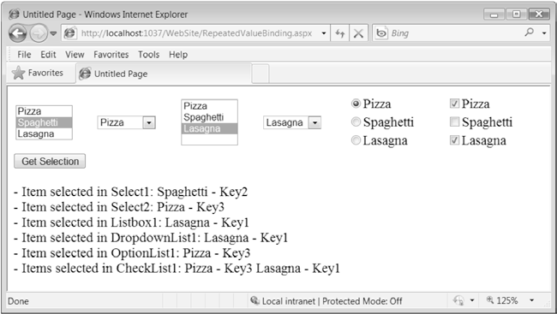
Repeated-value data binding in list controls

Slide 15
Protected Sub cmdGetSelection_Click(
ByVal sender As Object, ByVal e As System.EventArgs
) Handles cmdGetSelection.Click
If Select1.SelectedIndex <> -1 Then
Result.Text &= "- Item selected in Select1: " &
Select1.Items(Select1.SelectedIndex).Text &
" - " & Select1.Value & "<br>"
End If
If Select2.SelectedIndex <> -1 Then
Result.Text &= "- Item selected in Select2: " &
Select2.Items(Select2.SelectedIndex).Text &
" - " & Select2.Value & "<br>"
End If
If Listbox1.SelectedIndex <> -1 Then
Result.Text &= "- Item selected in Listbox1: " &
Listbox1.SelectedItem.Text & " - " &
Listbox1.SelectedItem.Value & "<br>"
End If
If DropdownList1.SelectedIndex <> -1 Then
Result.Text &= "- Item selected in DropdownList1: " &
DropdownList1.SelectedItem.Text & " - " &
DropdownList1.SelectedItem.Value & "<br>"
End If
If OptionList1.SelectedIndex <> -1 Then
Result.Text &= "- Item selected in OptionList1: " &
OptionList1.SelectedItem.Text & " - " &
OptionList1.SelectedItem.Value & "<br>"
End If
If CheckList1.SelectedIndex <> -1 Then
Result.Text &= "- Items selected in CheckList1: "
For Each li As ListItem In CheckList1.Items
If li.Selected Then
Result.Text &= li.Text & " - " & li.Value & " "
End If
Next
End If
End Sub

Slide 16
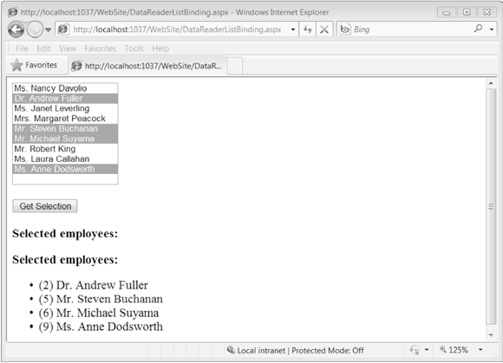
Data binding with a DataReader

Slide 17
Declaration of the data-bound list box
<asp:ListBox runat="server" ID="lstNames" Rows="10" SelectionMode="Multiple"
DataTextField="FullName" DataValueField="EmployeeID"/>

Slide 18
Code-behind that handles the Page_Load event
Protected Sub Page_Load(
ByVal sender As Object, ByVal e As System.EventArgs
) Handles Me.Load
If Not Page.IsPostBack Then
' Create the Command and the Connection.
Dim connectionString As String =
WebConfigurationManager.ConnectionStrings("Northwind").ConnectionString
Dim sql As String = "SELECT EmployeeID, TitleOfCourtesy + ' ' + " &
"FirstName + ' ' + LastName As FullName FROM Employees"
Dim con As SqlConnection = New SqlConnection(connectionString)
Dim cmd As SqlCommand = New SqlCommand(sql, con)
Try
' Open the connection and get the DataReader.
con.Open()
Dim reader As SqlDataReader = cmd.ExecuteReader()
' Bind the DataReader to the list.
lstNames.DataSource = reader
lstNames.DataBind()
reader.Close()
Finally
' Close the connection.
con.Close()
End Try
End If
End Sub

Slide 19
Code for determining the selected items
Protected Sub cmdGetSelection_Click(ByVal sender As Object, ByVal e As System.EventArgs
) Handles cmdGetSelection.Click
Result.Text &= "<b>Selected employees:</b><ul>"
For Each li As ListItem In lstNames.Items
If li.Selected Then _
Result.Text &=
String.Format("<li>({0}) {1}</li>", li.Value, li.Text)
EndIf
Next
Result.Text &= "</ul>"
End Sub

Slide 20
The Rich Data Controls
Support repeated-value binding
Rich data controls include the following
GridView
DetailsView
FormView

Slide 21
GridView
GridView provides a DataSource property for the data object and a DataBind() method that triggers it to read the data object and display each record
Automatically generates a column for every property
<asp:GridView ID="grid" runat="server" AutoGenerateColumns="true" />

Slide 22
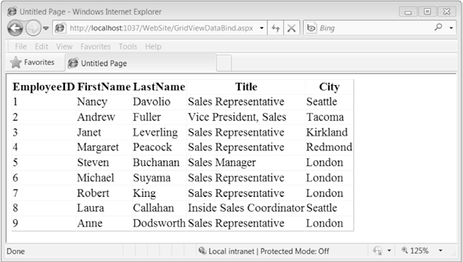
Binding DataReader to GridView
To bind the GridView to a DataReader
grid.DataSource = reader
grid.DataBind()
Sample output from GridView

Slide 23
Binding to a DataView
Limitations of binding to DataReader
can’t bind data to multiple controls
Can’t apply custom sorting and filtering criteria on the fly
Code is locked into the data provider currently in used
Disconnected DataSet overcomes the limitations above
But technically never bind directly to a DataSet or DataTable object but instead bind to a DataView object
Example
grid.DataSource = dataTable.DefaultView
grid.DataBind()

Slide 24
Binding DataView to GridView
Example of binding DataView to GridView
Dim connectionString As String =
"Data Source=.\SQLExpress;" &
"AttachDBFilename=|DataDirectory|\Northwnd.mdf;Integrated Security=SSPI;User Instance=True"
Dim sql As String =
"SELECT EmployeeID, FirstName, LastName, Title, City FROM Employees"
Dim con As New SqlConnection(connectionString)
Dim cmd As New SqlCommand(sql, con)
Dim da As New SqlDataAdapter(cmd)
Dim ds As New DataSet
Dim dv As New DataView
da.Fill(ds)
dv = ds.Tables(0).DefaultView
gvEmployees1.DataSource = dv
gvEmployees1.DataBind()

Slide 25
Demo: Binding DataReader to ListBox
The markup:-
<asp:ListBox runat="server" ID="lstNames" Rows="10" SelectionMode="Multiple"
DataTextField="FullName" DataValueField="EmployeeID" />
The code behind the page:-
Dim sql As String = "SELECT EmployeeID, TitleOfCourtesy + ' ' + " & _
"FirstName + ' ' + LastName As FullName FROM Employees“
Dim reader As SqlDataReader = cmd.ExecuteReader()
' Bind the DataReader to the list.
lstNames.DataSource = reader
lstNames.DataBind()

Slide 26
Handling the Click event for ListBox
Protected Sub cmdGetSelection_Click(
ByVal sender As Object, ByVal e As System.EventArgs
) Handles cmdGetSelection.Click
Result.Text &= "<b>Selected employees:</b><ul>"
For Each li As ListItem In lstNames.Items
If li.Selected Then _
Result.Text &=
String.Format("<li>({0}) {1}</li>", li.Value, li.Text)
Next
Result.Text &= "</ul>"
End Sub
li.Value will provide the EmployeeID and li.Text will provide the FullName.

